Slide 1
PRESENTATION
TO
SPECIAL INVESTIGATORY COMMITTEE
ON JEA MATTERS

Slide 2
Our Role
Nelson Mullins interviewed to represent the City Council in connection with consideration of a possible sale of JEA.
Together with our Energy team, we conducted extensive due diligence, including review of JEA board meetings and materials, financial statements and public filings, industry reports and materials relating to the ITN process.
Our team included the former CEO of a government owned utility.

Slide 3
Our Role
We gained an understanding of the challenges facing government-owned utilities and JEA in particular.
We also determined that the quality of information provided to the board was inadequate.
We published an op-ed to encourage an open and transparent conversation about JEA and subsequently provided our due diligence memorandum to the City Council.

Slide 4
Trends Impacting JEA
Scale and territorial growth will be critical for adapting to a new regulatory and competitive environment for utilities.
JEA’s financial value may have peaked, as only modest growth is expected over the next 10 years.
JEA’s debt burden and Plant Vogtle commitment, coupled with JEA’s customer mix, modest growth projections and fundamental changes in the energy and utilities markets, creates a higher level of enterprise risk;
Carbon tax legislation, which continues to gain industry and bipartisan political support, will drive further adaptations by utilities.
JEA has significant value, and a sale could provide a transformative opportunity for the City to achieve other goals.

Slide 5
Areas of Concern re Quality of Information
The 8% decline in unit sales (MWh) over the past 12 years;
The 8% projected decline in unit sales over the next 12 years;
The performance unit plan that created powerful incentives for management to push for a sale; and
The strategic planning process, including legal constraints and proposed alternatives, and management’s intentions regarding the new downtown headquarters.

Slide 6
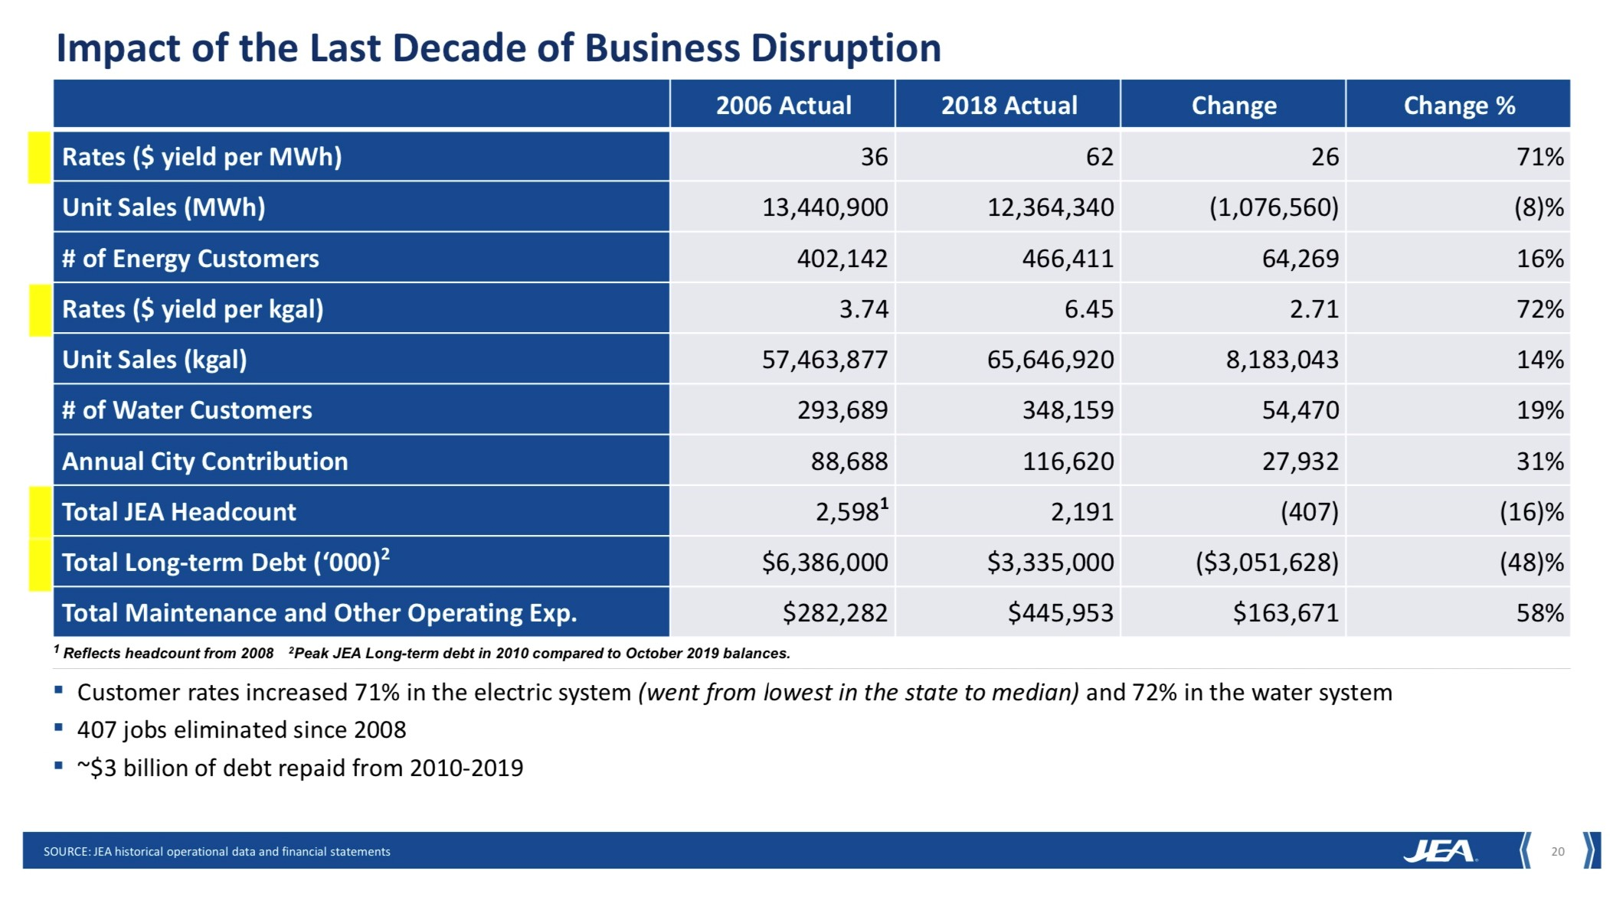
I. The 8% Decline in Electric Sales
Impact of the Last Decade of Business Disruption
Slide from May, June and July 2019 Board Meetings

Slide 7
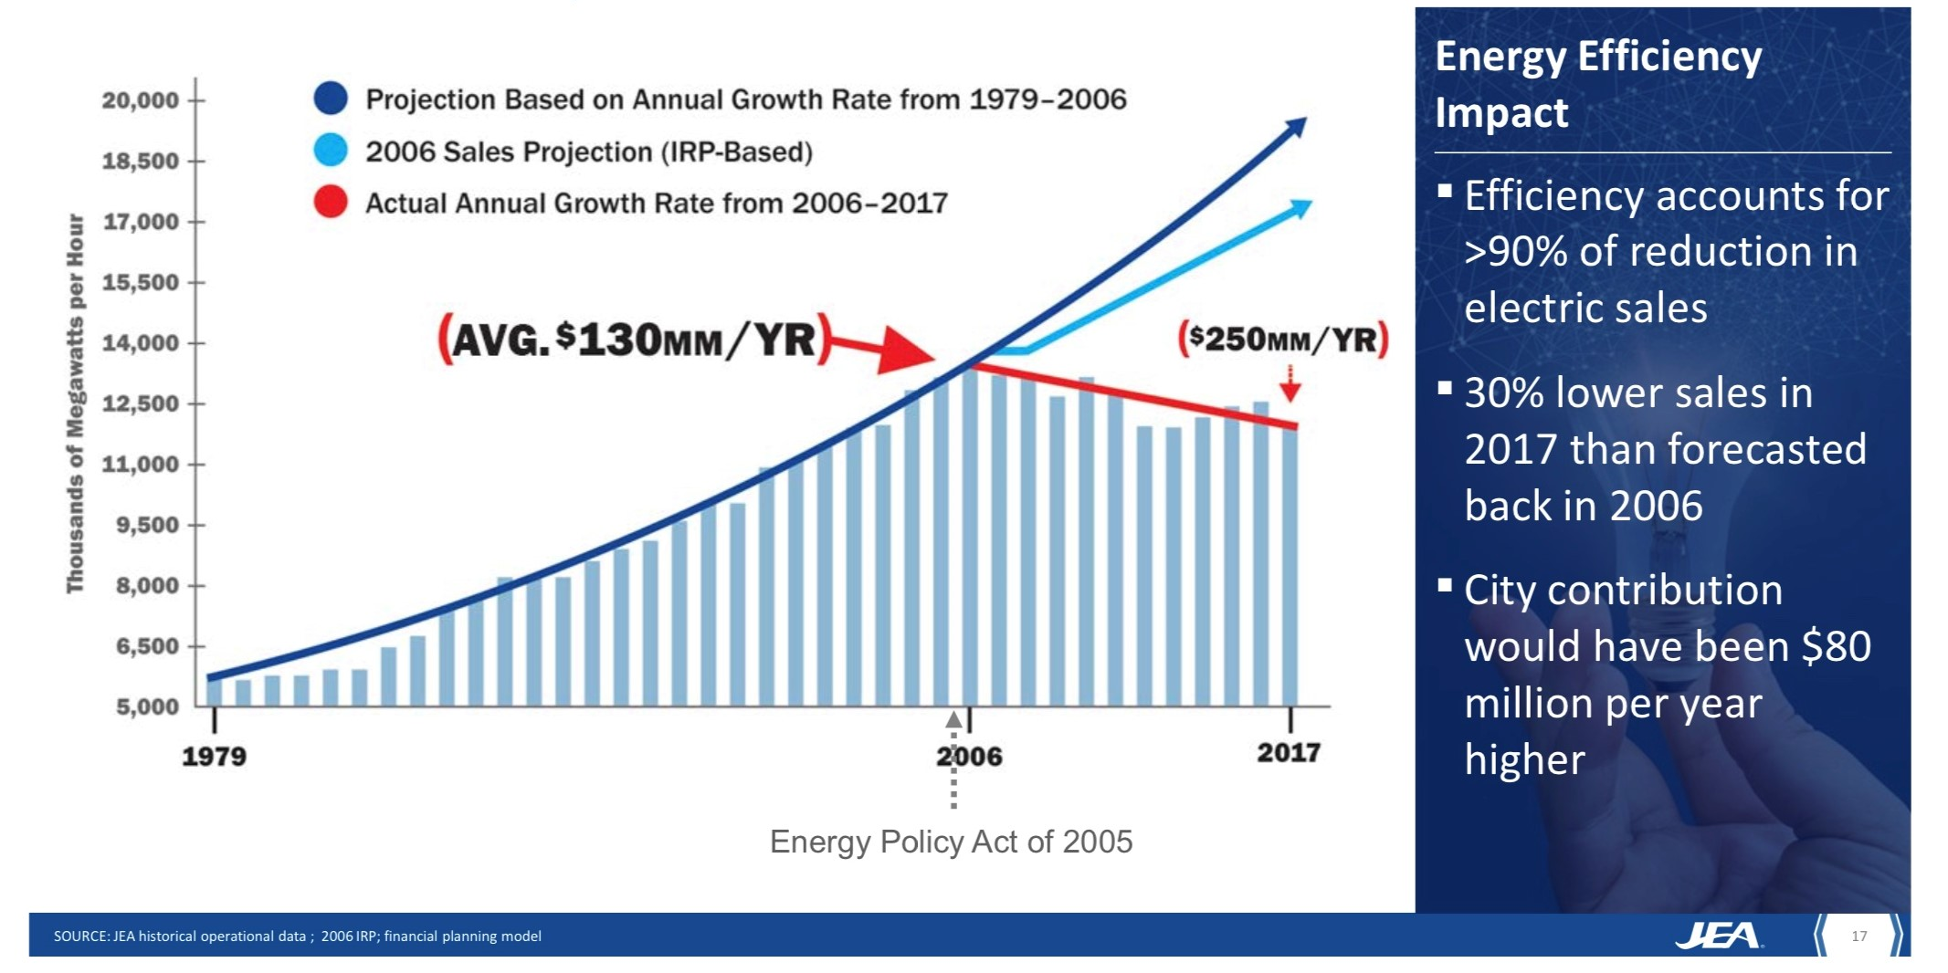
2007 to 2017: Loss of
$1.4 Billion in Free Cash Flow
Slide from May 2019 Board Meeting

Slide 8
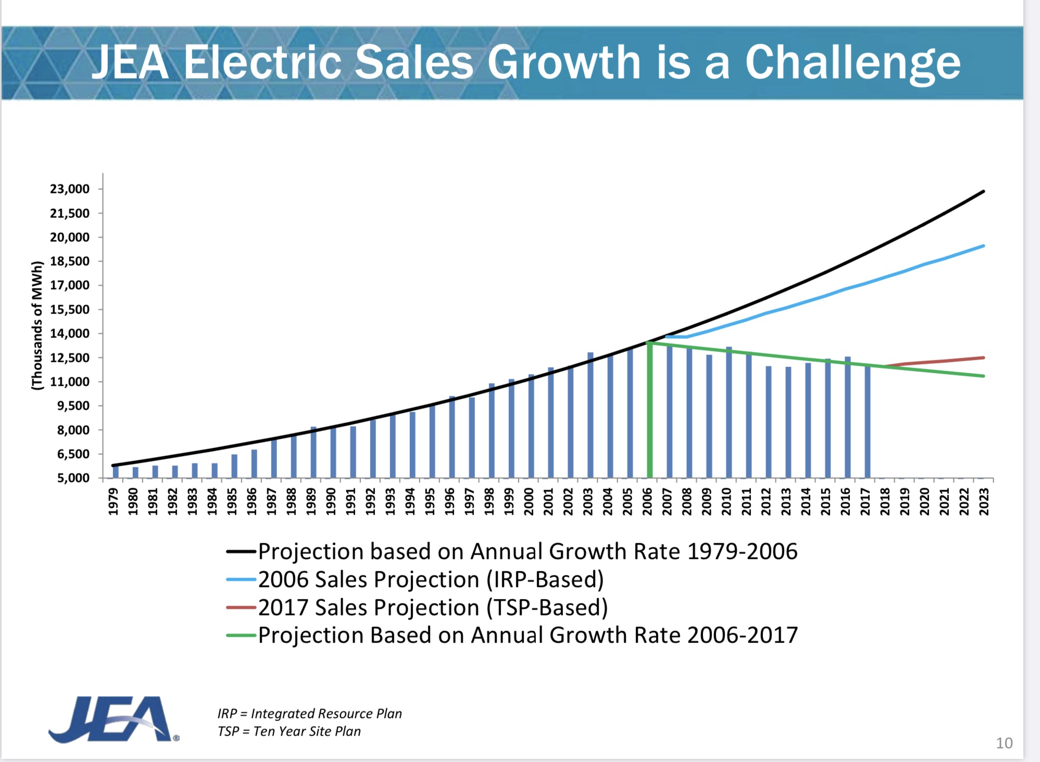
JEA Electric Sales Growth is a Challenge
Slide from April 2018 Board Workshop on Privatization

Slide 9
Analysis of MWh Sales Decline
2006 - 2018
Sales (MWh) | 2006 | 2018 | % Change | % of Total Decline
Residential | 5,650,986 | 5,414,721 | (4.2%) | 22%
Commercial and Industrial | 7,157,602 | 6,851,803 | (4.3%) | 28%
Street Lighting | 110,178 | 59,176 | (46.3%) | 5%
Territorial Sales for Resale | 522,134 | 38,640 | (92.6%) | 45%
Total | 13,440,900 | 12,364,340 | (8%)

Slide 10
Retail MWh Sales
2012 - 2019
Fiscal Year | Residential MWh Sales | Commercial/Industrial | Total Retail Sales
2012 | 4,806,144 | 6,670,200 | 11,476,344
2013 | 4,877,264 | 6,599,249 | 11,476,513
2014 | 5,086,866 | 6,636,445 | 11,723,311
2015 | 5,243,002 | 6,767,836 | 12,010,838
2016 | 5,328,245 | 6,847,583 | 12,175,828
2017 | 5,108,945 | 6,725,201 | 11,834,146
2018 | 5,414,721 | 6,851,803 | 12,266,524
2019 | 5,515,428 | 6,793,603 | 12,308,985

Slide 11
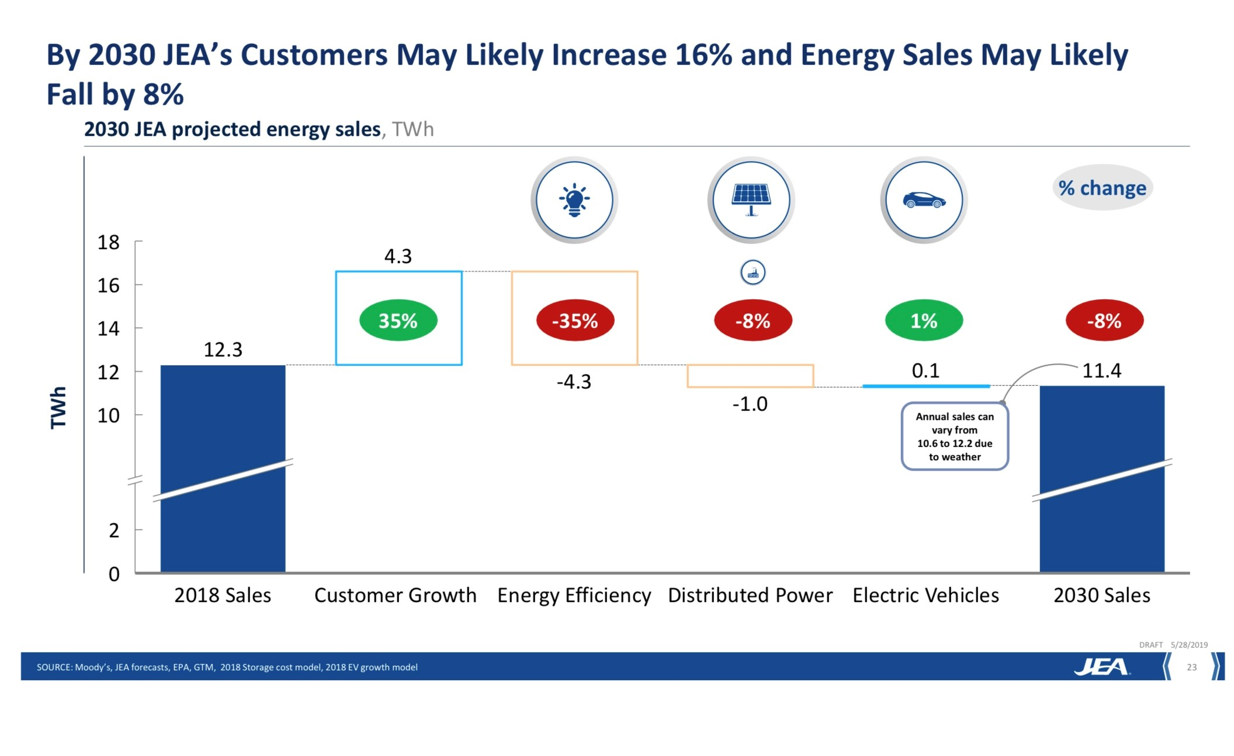
II. Projected 8% of MWh Sales Decline Over Next 12 Years
Slide from May 2019 Board Meeting

Slide 12
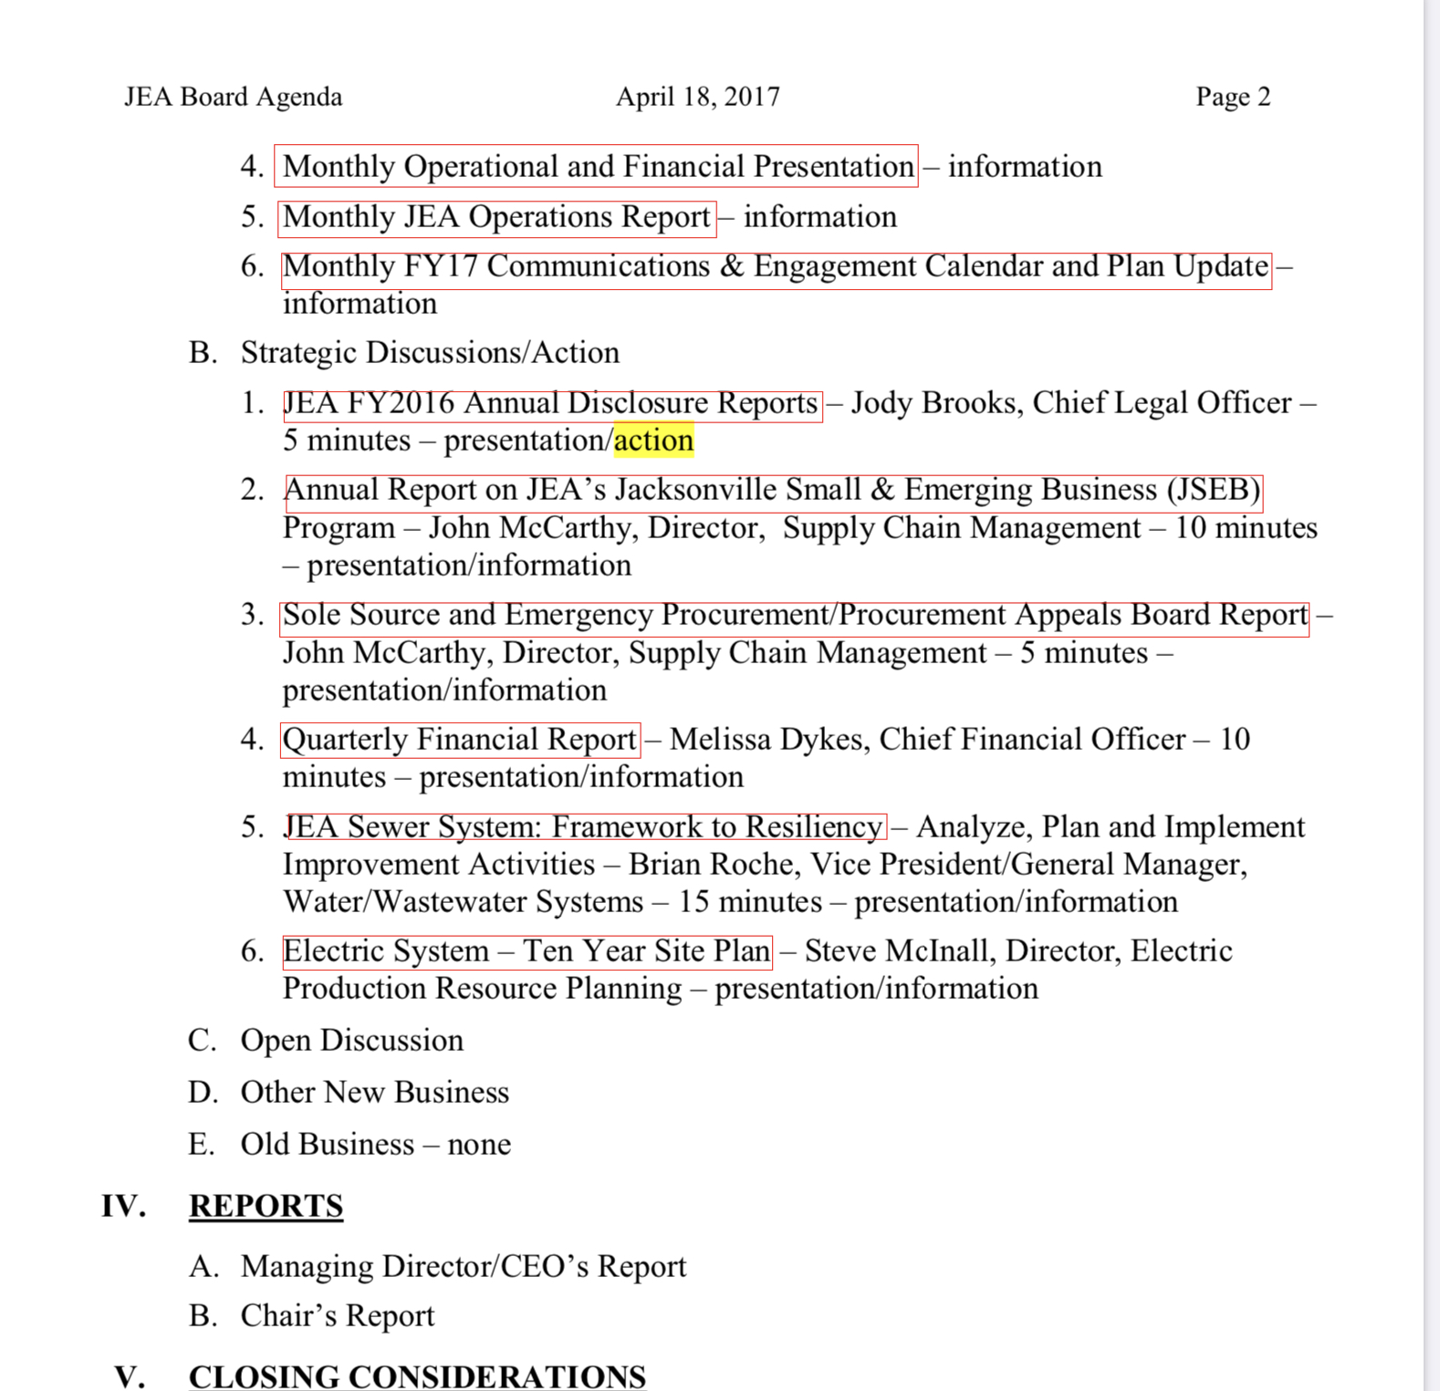
Ten-Year Site Plan
Agenda from April 2017 Board Meeting

Slide 13
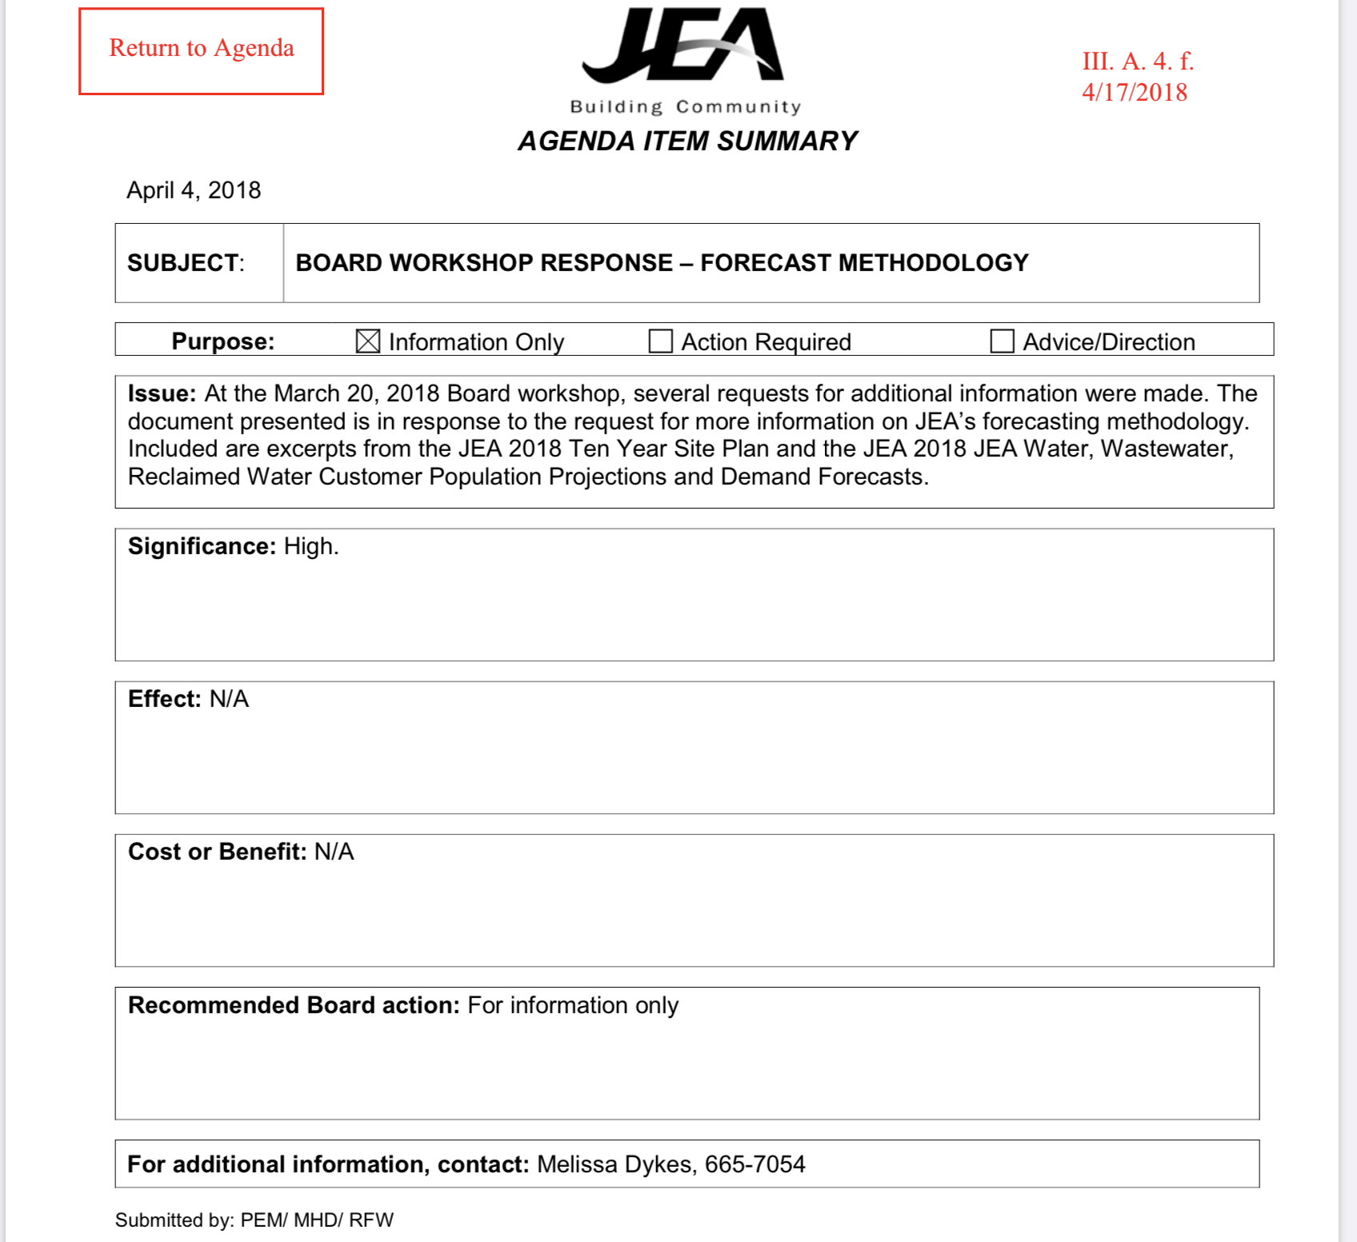
Ten-Year Site Plan
Slide from April 2018 Board Meeting

Slide 14
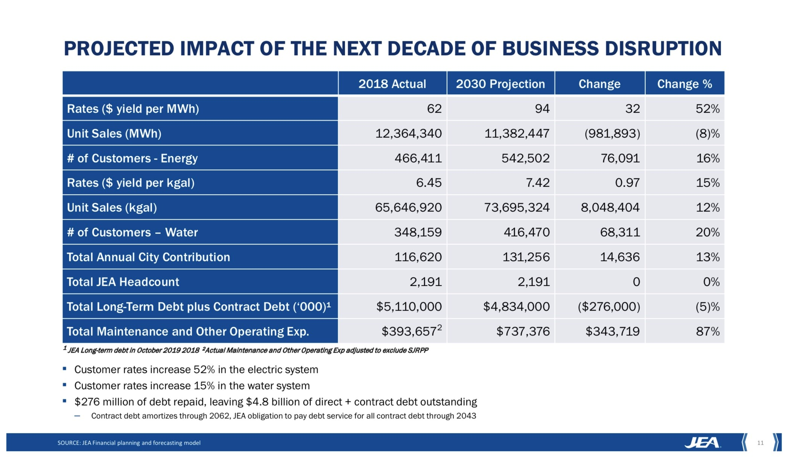
Projected Impact of the Next Decade of Business Disruption
Slide from June 2019 Board Meeting

Slide 15
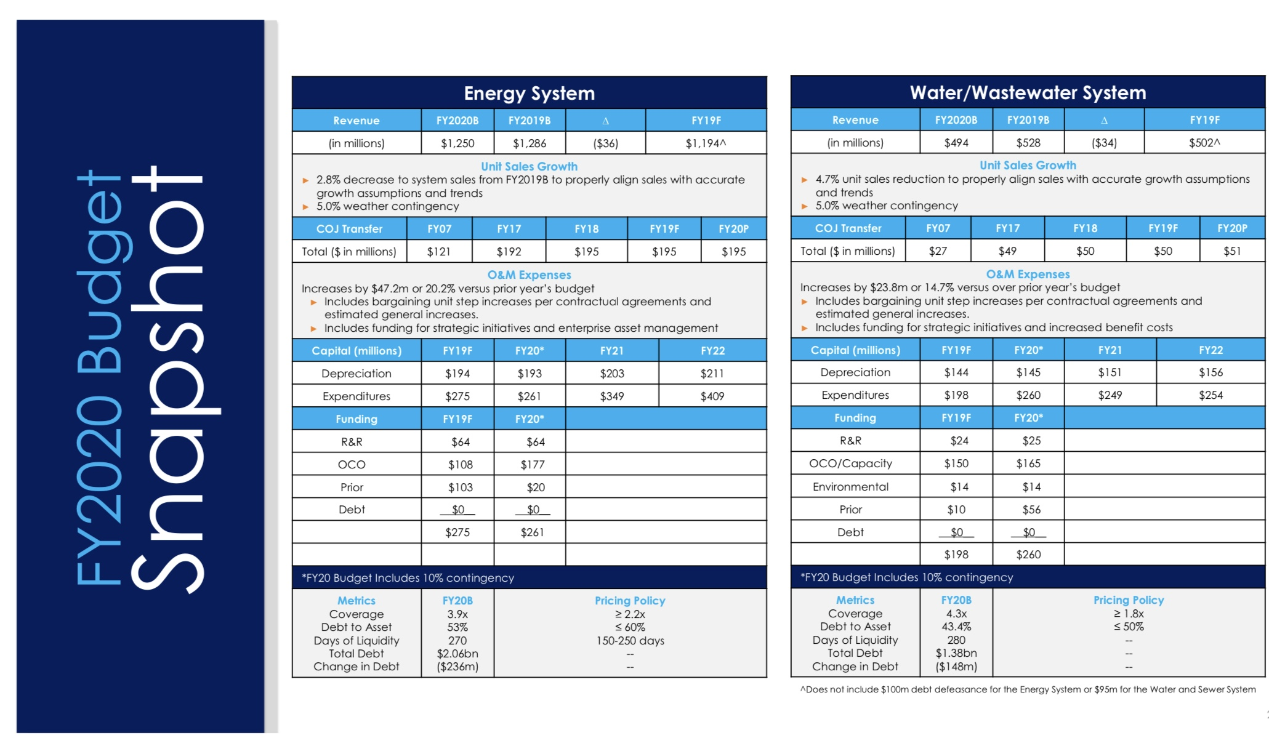
FY2020 Budget Snapshot
Slide from June 2019 Board Meeting

Slide 16
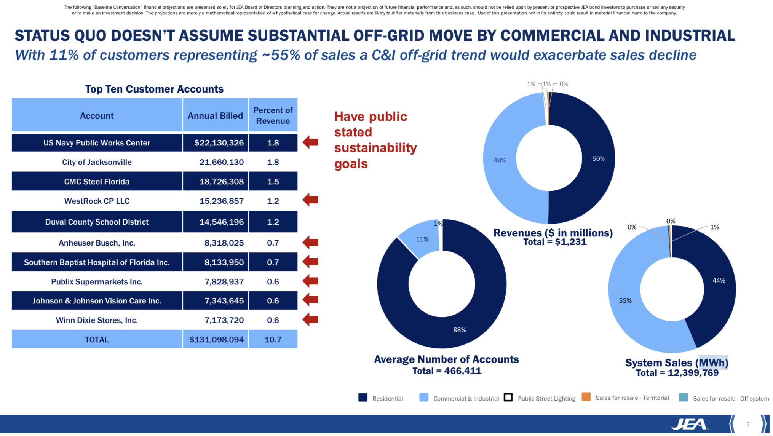
Sustainability Goals
Slide from July 23, 2019 Board Meeting

Slide 17
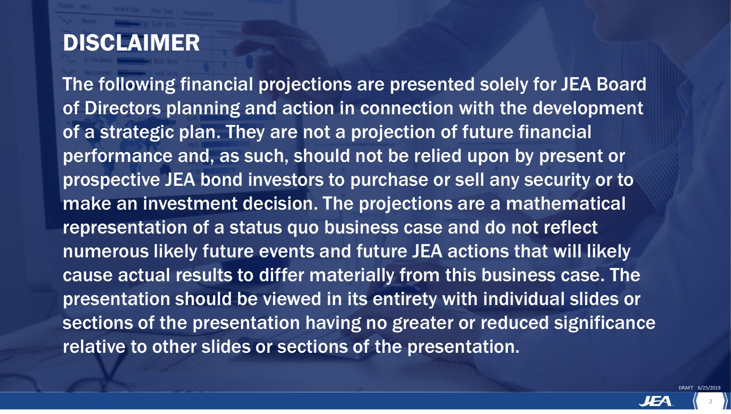
Disclaimer
Slide from June 2019 Board Meeting

Slide 18
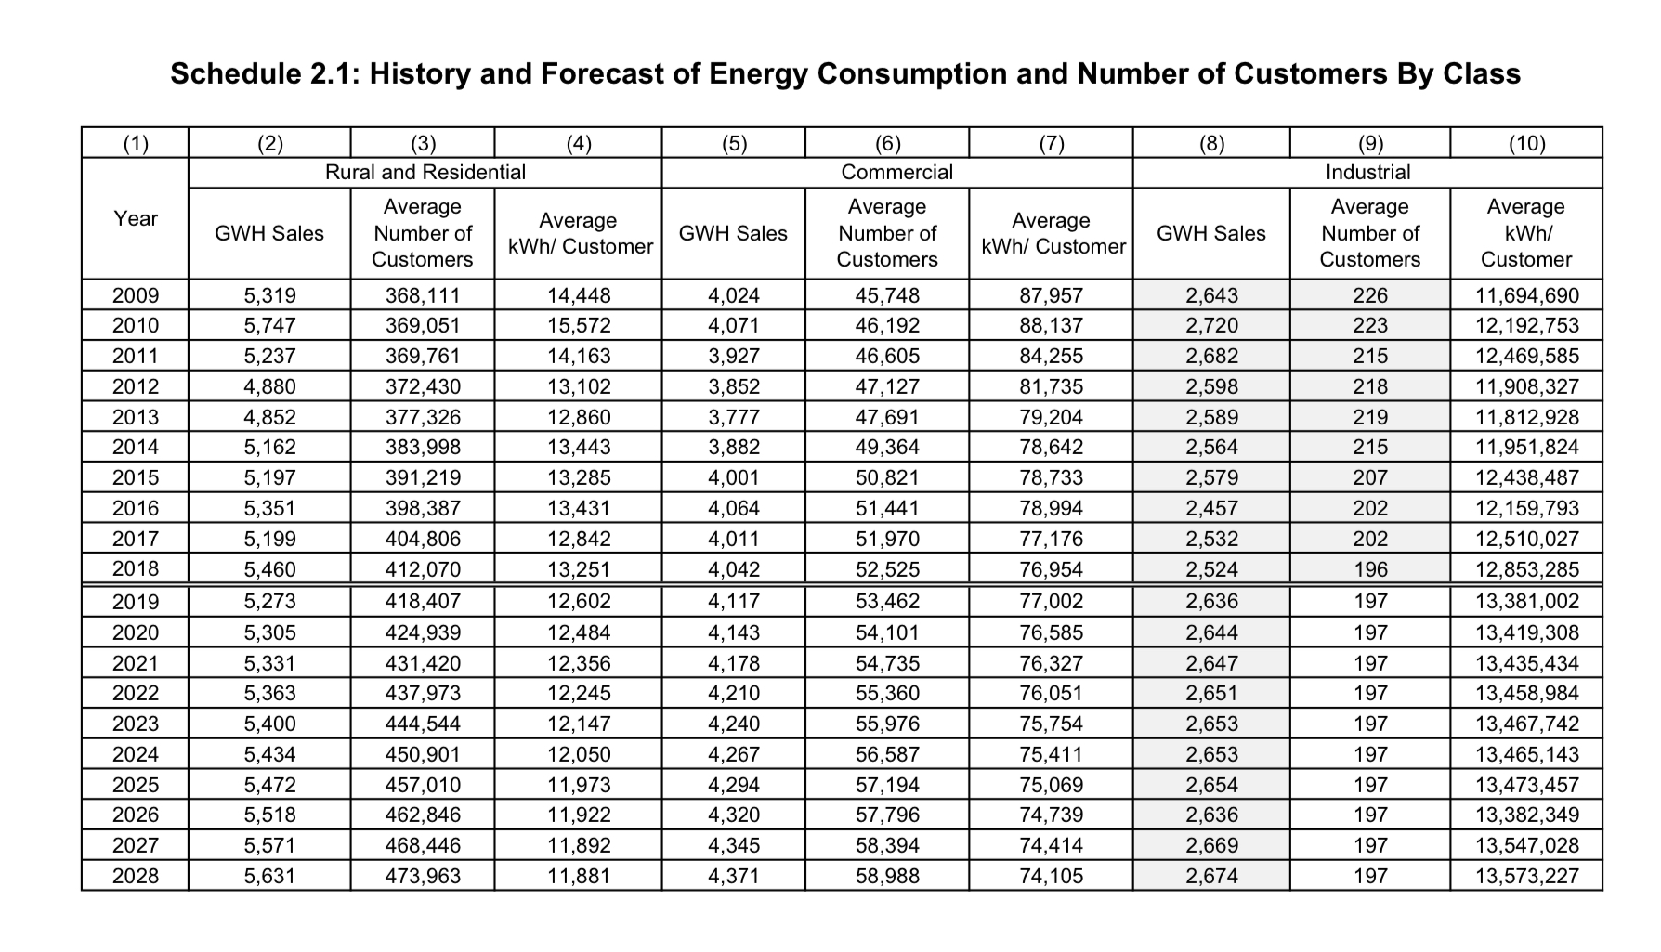
Schedule 2.1: History and Forecast of Energy Consumption and Number of Customers By Class
Excerpt from Ten-Year Site Plan filed July 17, 2019

Slide 19
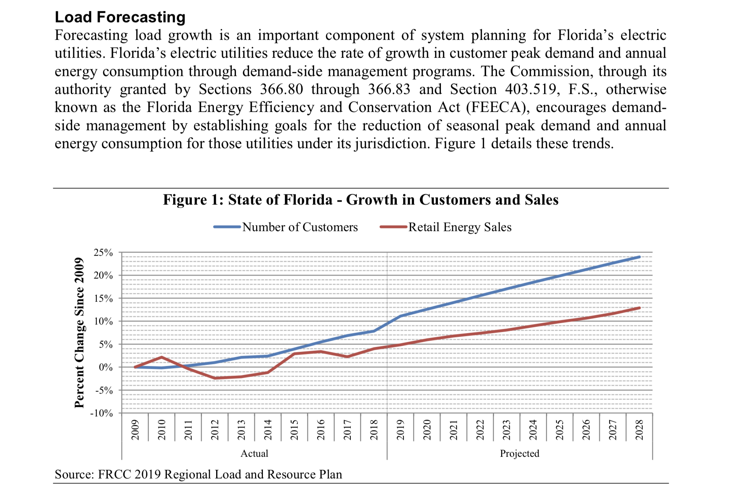
Load Forecasting
Excerpt from PSC Review of the 2019 Ten-Year Site Plans for Florida’s Electric Utilities

Slide 20
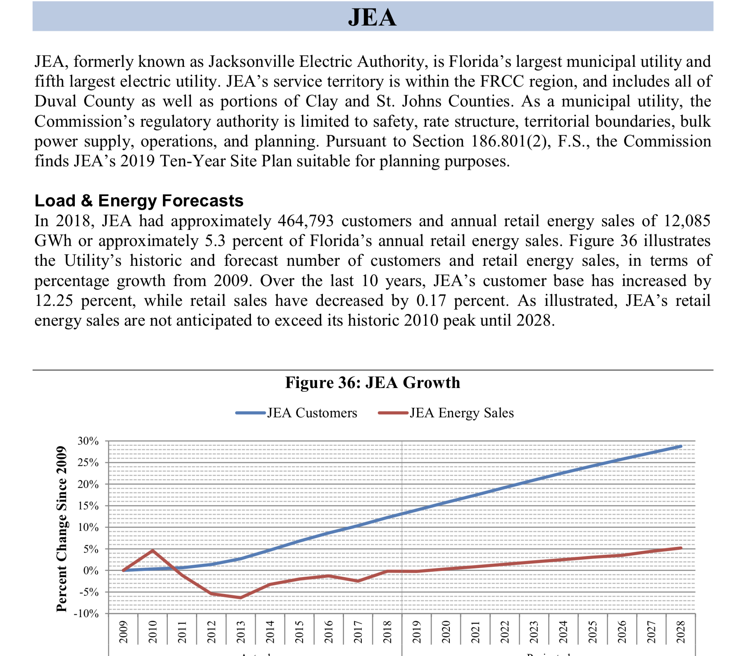
JEA Load Forecasting
Excerpt from PSC Review of the 2019 Ten-Year Site Plans for Florida’s Electric Utilities

Slide 21
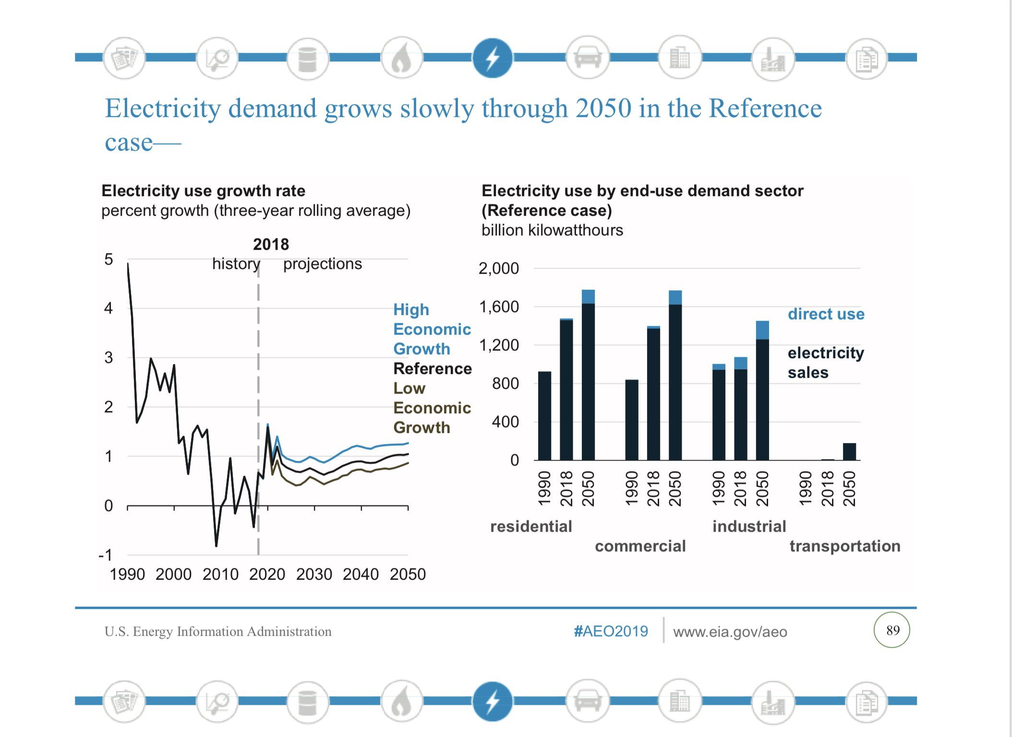
Electricity Demand
Excerpt from U.S. Energy Information Administration Annual Energy Outlook 2019

Slide 22
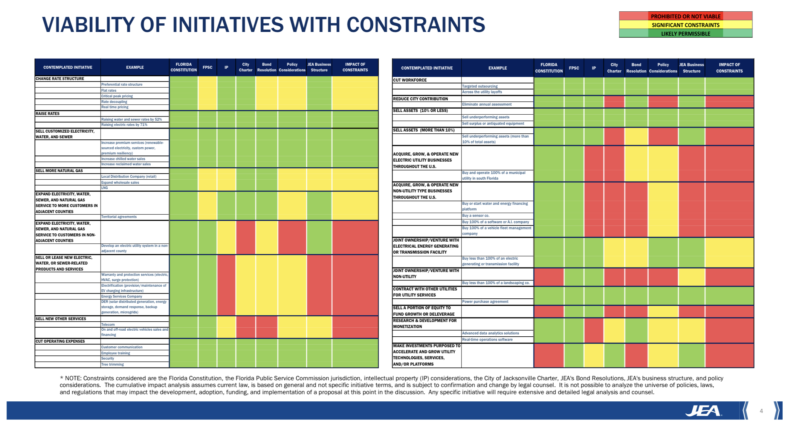
III. Strategic Planning Process
Legal Constraints

Slide 23
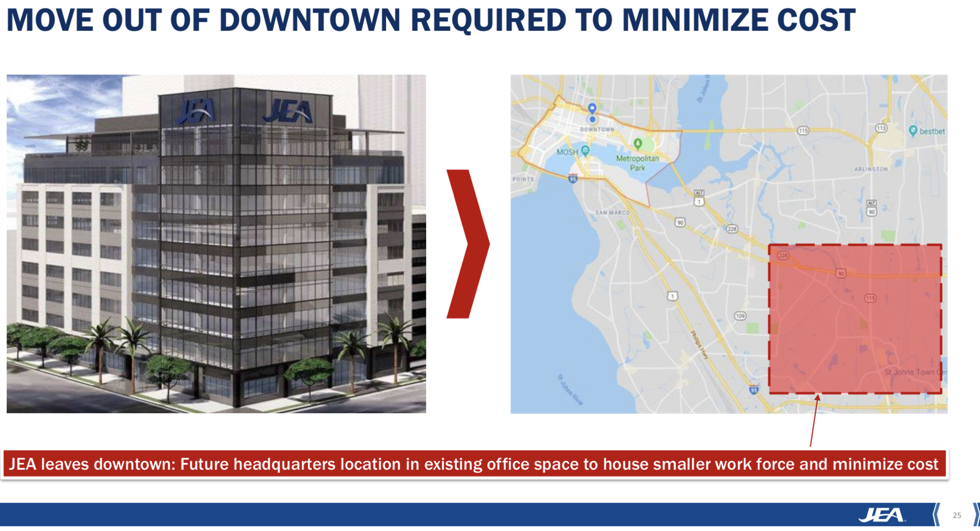
III. Strategic Planning Process
Downtown Lease
Excerpt from June 2019 Board Materials

Slide 24
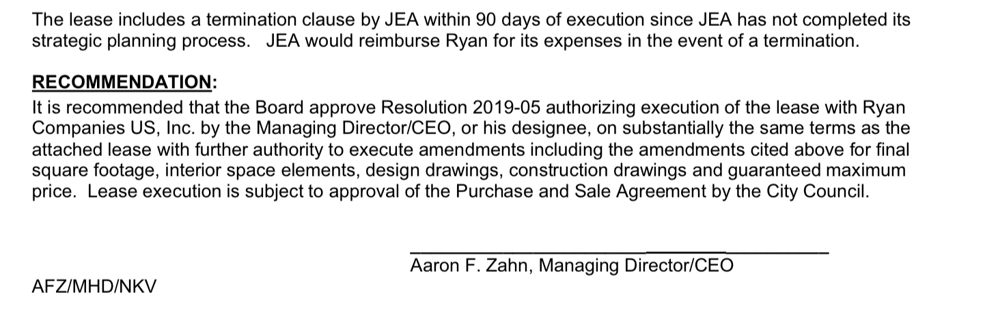
III. Strategic Planning Process
Downtown Lease
Excerpt from June 2019 Board Materials

Slide 25
III. Strategic Planning Process
Initial Public Offering
There is a threshold legal question as to whether Florida Constitution allows JEA to conduct an IPO. No attorney general opinion was sought.
JEA has more value to a strategic buyer than to the public markets because of the importance of scale, the limited growth profile for JEA and the control premium.

Slide 26
III. Strategic Planning Process
Cooperative
A consortium of cooperatives could be to acquire JEA in the ITN process but no bids emerged.
A new cooperative could not finance the purchase at a price close to what an IOU could pay.

Slide 27
IV. Performance Unit Plan
The performance unit plan (PUP) was designed to pay out to participants 10 % of the amount by which the sale price (plus customer rebates) exceeded $7.5 billion.
PUP units would be purchased at $10 and would increase by $100 for each Value Change Percentage (Current Year Value ÷ Base Year Value) above the Challenge Value Target (110% of the Base Year Value).

Slide 28
Calculation of Value Targets
Base Year Value is $3.2 billion, calculated as JEA Net Position on 12/31/19 ($3.037 billion) plus amounts paid to City in last 12 months ($133 million) plus customer rebates in last 12 months ($0)
Challenge Value Target is 110% of $3.2 billion, or $3.5 billion.
This assumes an enterprise value of $7.5 billion ($3.5 billion plus $4 billion liabilities (midpoint estimate from ITN)

Slide 29
Unit Values upon $10 B Sale
Upon a $10 billion sale under the terms of the ITN, the Current Year Value changes to $6.4 billion ($10 billion purchase price, minus $4 billion debt, plus $400 million customer rebate.
The Value Change Percentage is 82%, so units increase in value from $10 to $8210.
With 30,000 units issued, this is a $246 million payout.

Slide 30
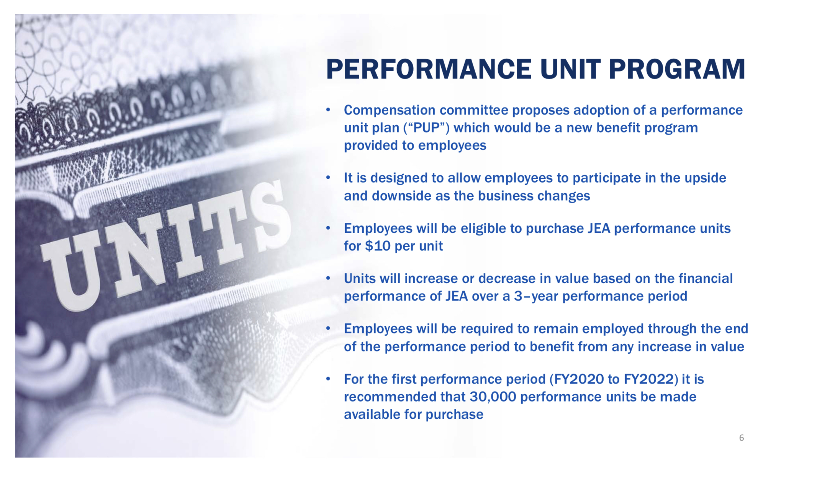
What was Disclosed to the Board about PUP
Slide from July 23, 2019 Board Materials

Slide 31
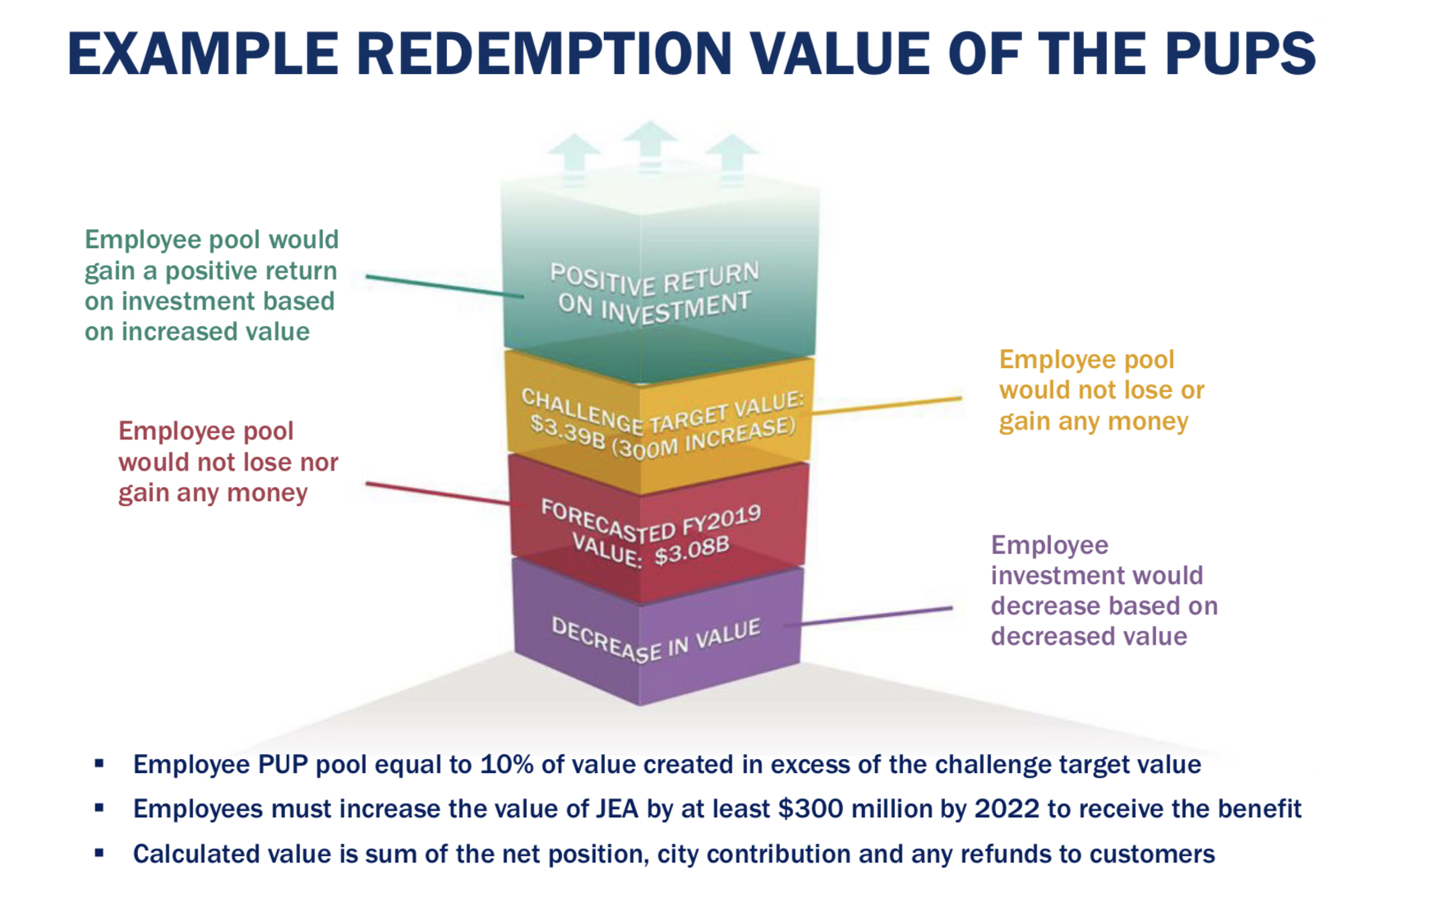
What was Disclosed to the Board about PUP
Slide from July 23, 2019 Board Materials

Slide 32
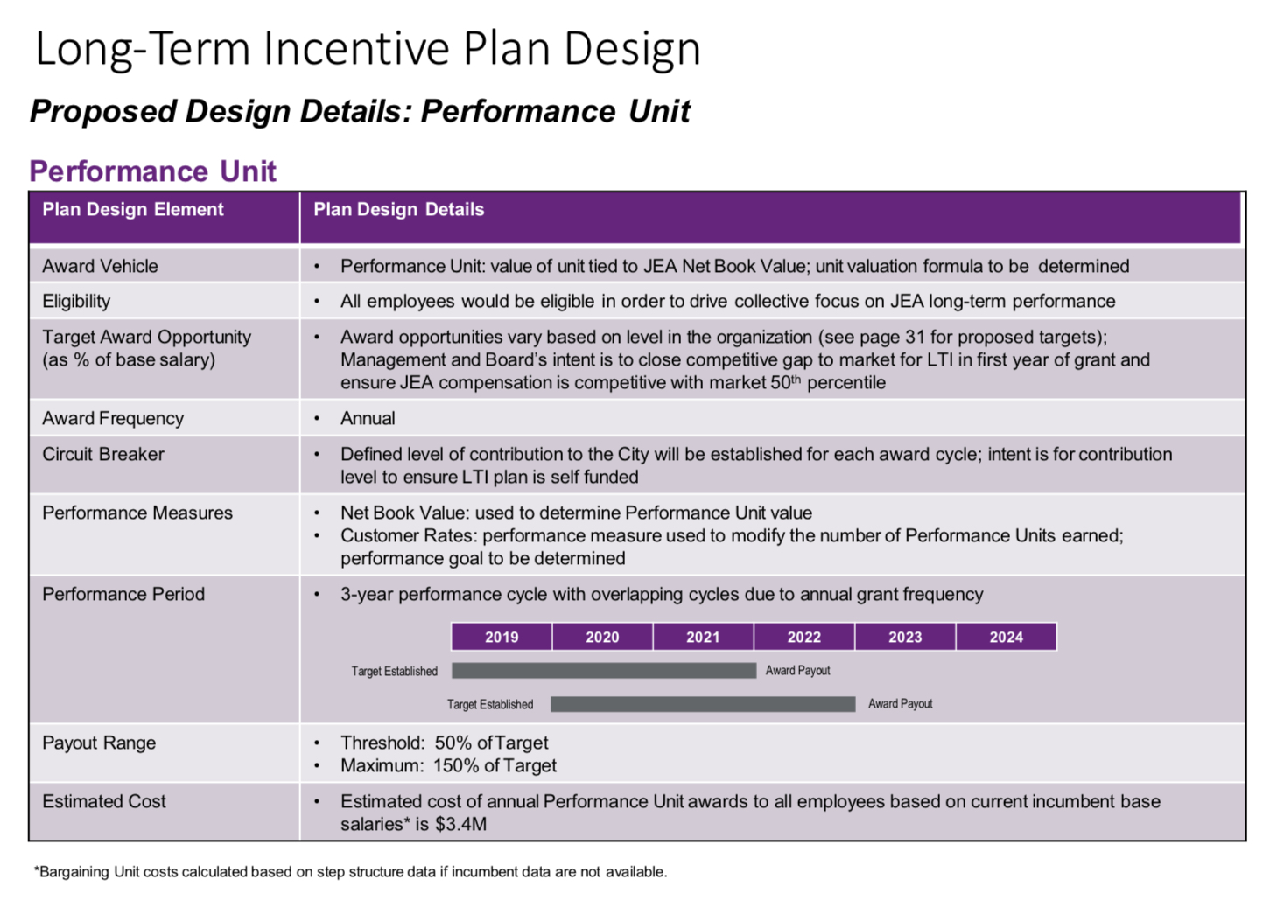
What was Disclosed to the Board about PUP
Slide from July 23, 2019 Board Materials

Slide 33
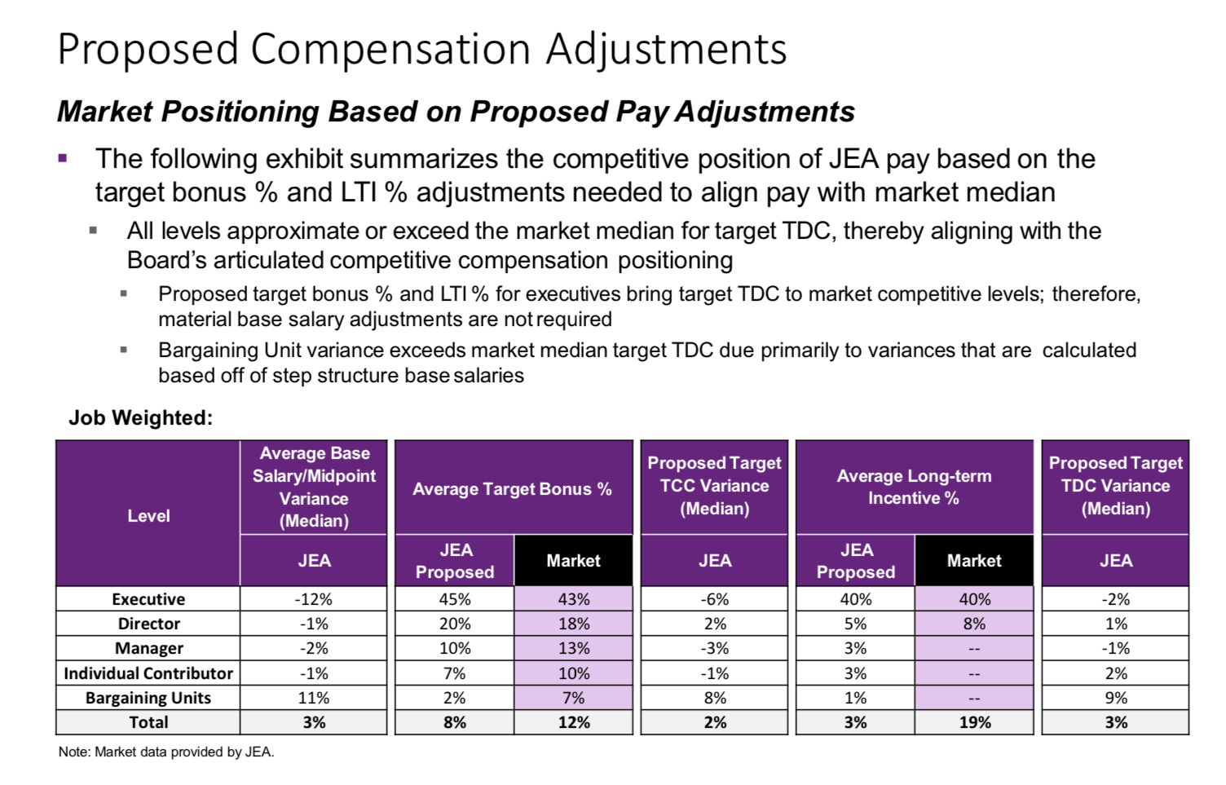
What was Disclosed to the Board about PUP
Slide from July 23, 2019 Board Materials

Slide 34
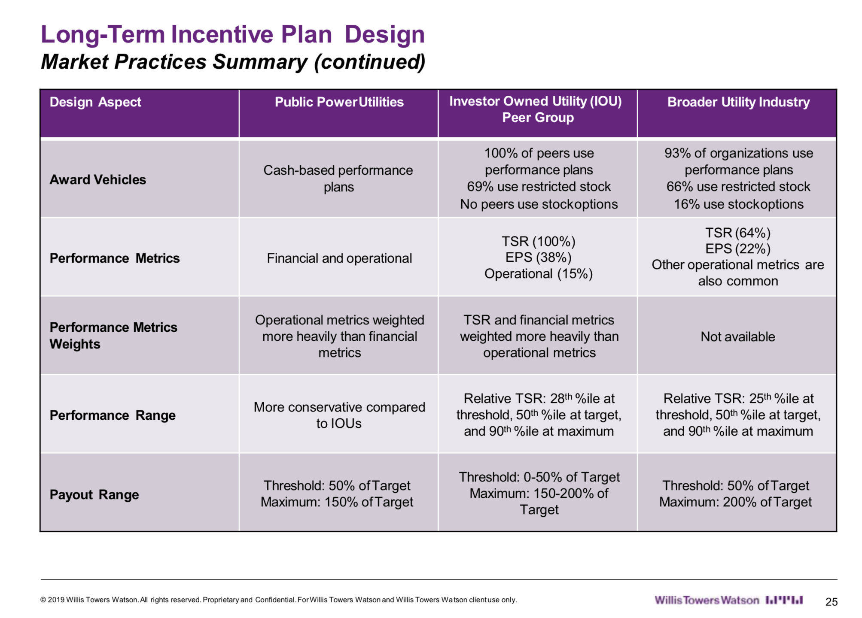
What was Disclosed to the Board about PUP
Slide from July 23, 2019 Board Materials

Slide 35
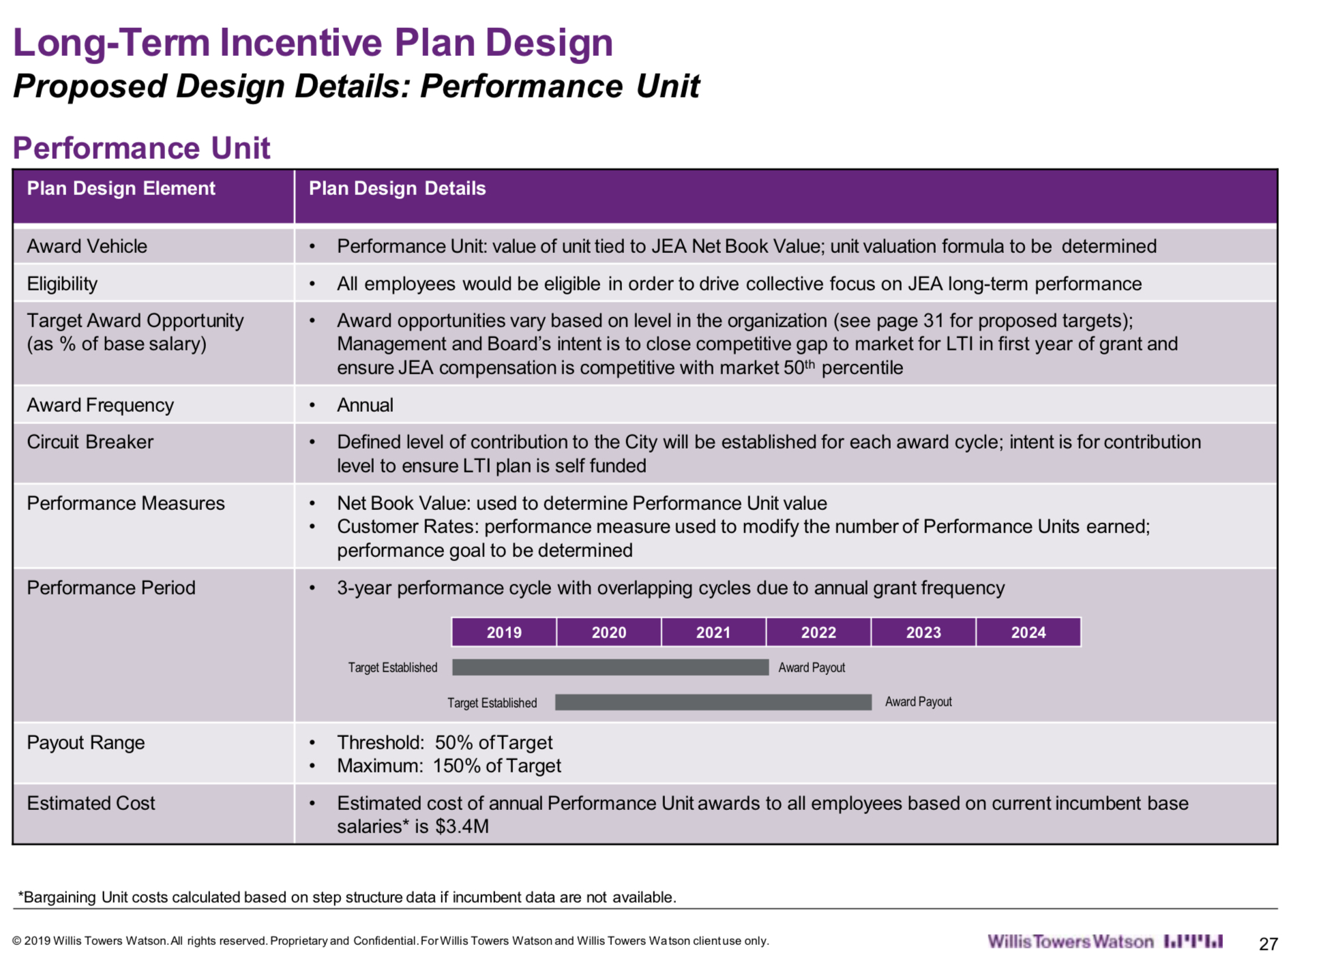
What was Disclosed to the Board about PUP
Slide from July 23, 2019 Board Materials

Slide 36
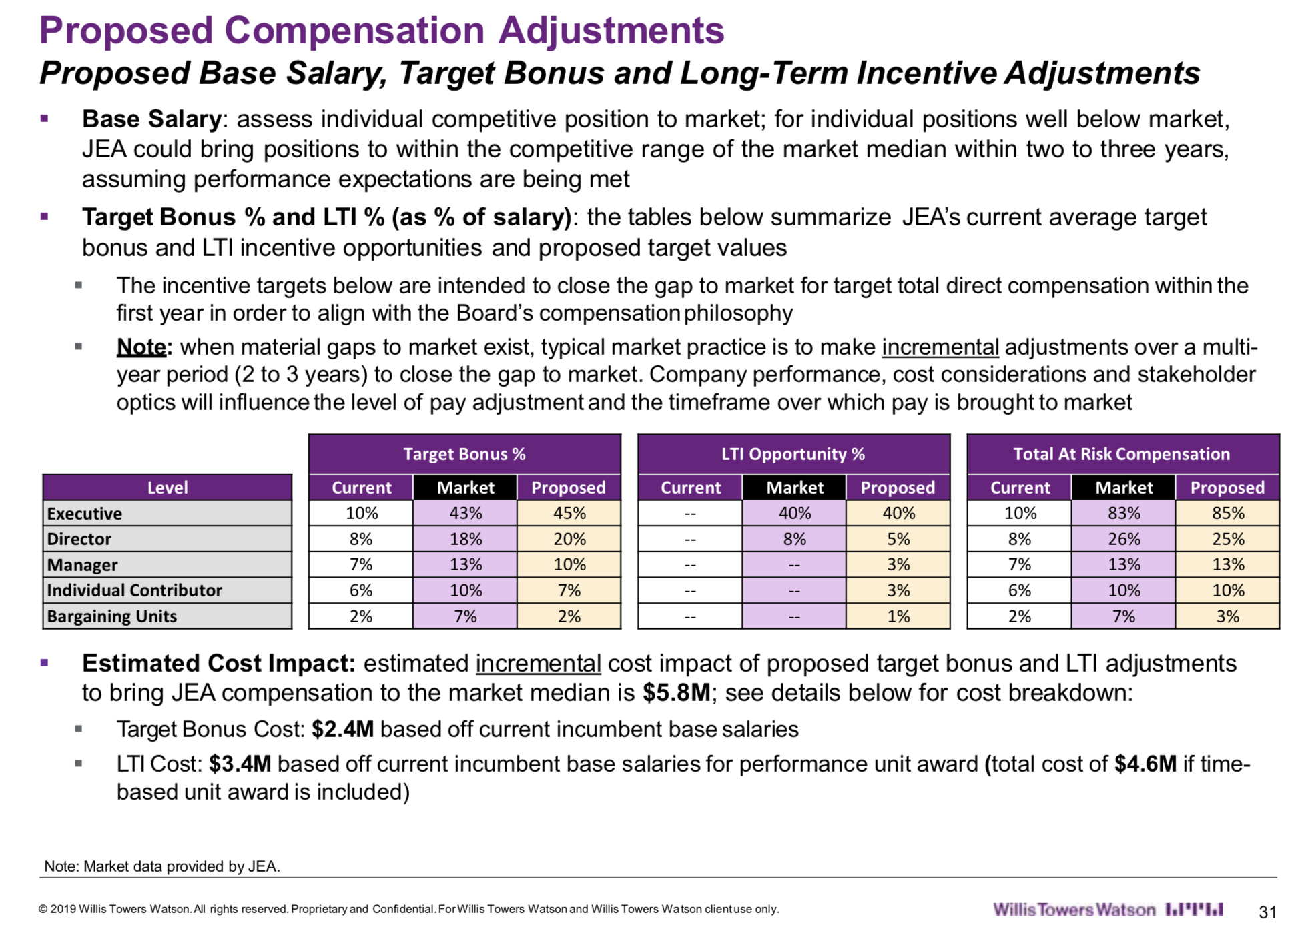
What was Disclosed to the Board about PUP
Slide from July 23, 2019 Board Materials

Slide 37
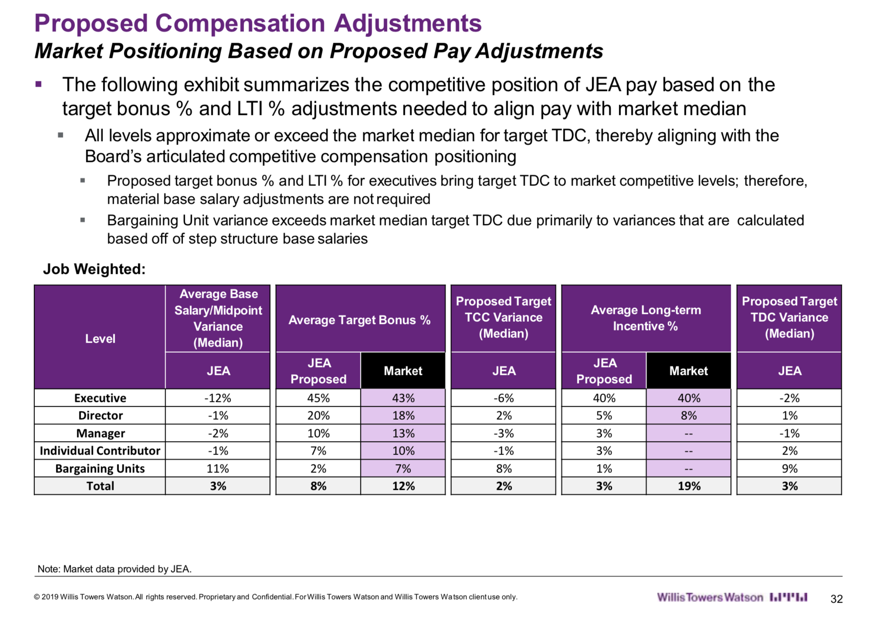
What was Disclosed to the Board about PUP
Slide from July 23, 2019 Board Materials

Slide 38
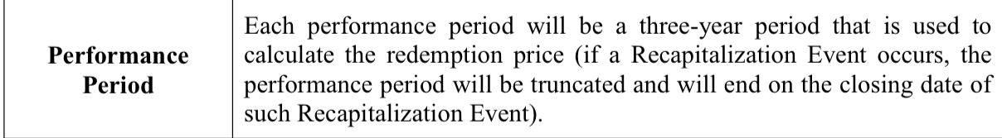
What was Disclosed to the Board about PUP
Slide from July 23, 2019 Board Materials

Slide 39
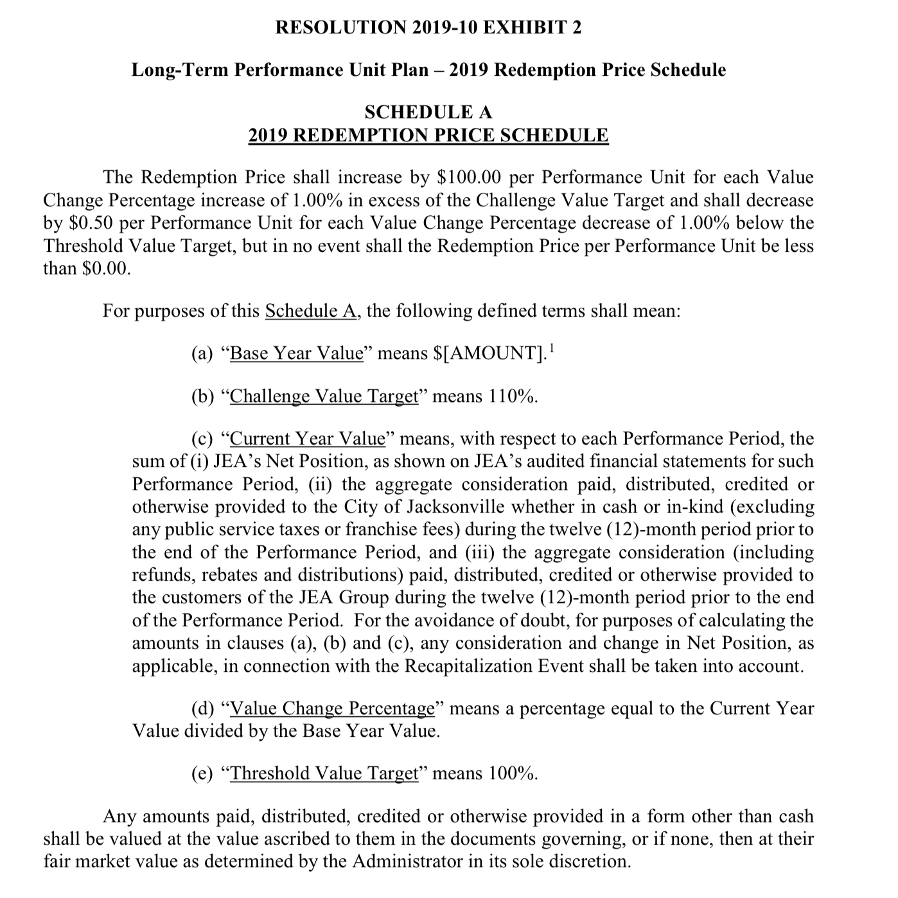
What was Disclosed to the Board about PUP
Slide from July 23, 2019 Board Materials

Slide 40
What the Board Wasn’t Told
OGC provided a detailed memorandum, to Lynn Rhode on June 17, 2019 outlining the restrictions on bonus or incentive compensation payments to public employees. Rather than present this memo, the lawyers structured the plan to attempt to avoid the restrictions.
The restrictions outlined in the OGC are based on the public policy that public funds may only be used for a public purpose, and it violates public policy to give extra compensation that has already been performed for an agreed wage.
The PUP plan created huge financial incentives for management to push for a sale rather than continued municipal ownership.

Slide 41
What the Board Wasn’t Told
(2:53:24 of video) Board chair Mr. Howard notes that there is accelerated vesting upon a recapitalization event. In response, management fails to point out the impact of the sale on the amount of the PUP payment.
(2:54:18 of video) Mr. Howard asks whether the plan has been approved by the OGC and Ms. Rhode replies in the affirmative (based on footnote 2 to an OCG memo to file and the subsequent OGC letter, this was not accurate).
(2:54:40 of video) Board member Ms. Flanagan asks Mr. Wannamacher to walk the board through how the value of the units is determined. He answers the question but fails to describe the impact of a sale on the value.
(2:55:49 of video) Ms. Flanagan asks about the implications of scenario 3 (a recapitalization) on the plan. Mr. Wannamacher responds that the only implication is that a recapitalization ends the performance period and that the calculation would be done at that time.

